Slide 1
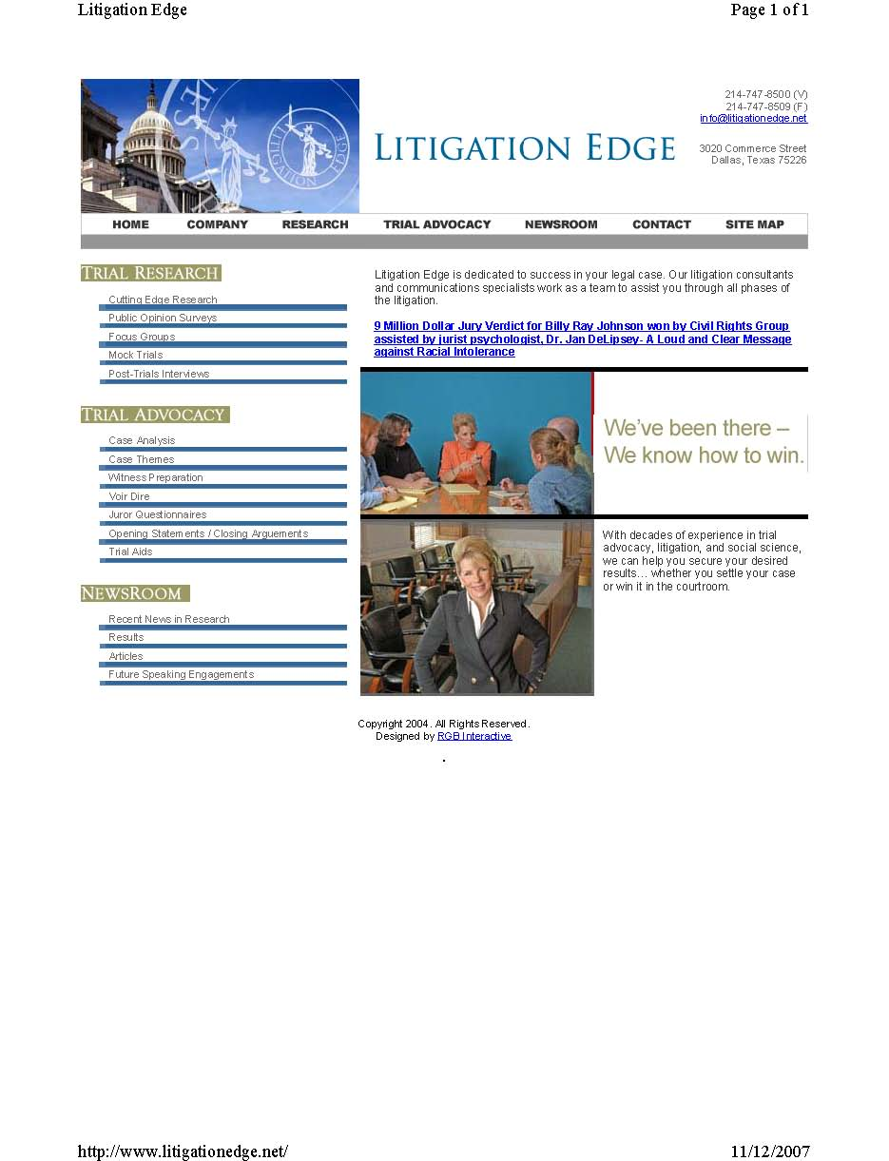
www.litigationedge.net
Notes:
I thought that I would start out today with a little ice breaker – something cute or funny to get you to laugh and it
occurred to me that there is nothing cute or funny about the right to trial by jury.
The law is not the private property of lawyers or judges
The blessings of freedom should belong to each of us
Trial by jury is a fundamental freedom.
In this country, we have the constitutionally guaranteed right to pick our own judges – the jury.
What an amazing concept - that ordinary, unbiased citizens can come together to decide serious disputes that have far reaching consequences is one of the most simple, yet brilliant , ways to secure and insure the blessing of liberty.
John Adams said that the right to trial by jury is the heart and lungs of democracy
Its democracy in its most basic form – the only way every citizen can participate in government.
And yet, Its so under appreciated
Even under appreciated by judges and lawyers who should be its most ardent trustees.
When you look at it this way, what legal proceeding is more important than voir dire?

Slide 2
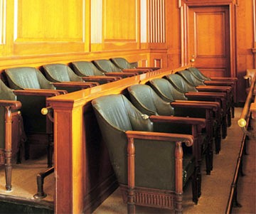
Jury De-Selection
INSERT PHOTO OF JURY HERE
Notes:
Attorneys always ask “Who do we want”
I always say “Whoever is left after we do a proper job of voir dire”
The term “jury selection” is misleading, etc.

Slide 3
Goal?
Seat a jury which will be open to
Your Argument.
Notes:
What is your ultimate goal of voir dire?
SEAT A JURY WHICH WILL BE OPEN TO YOUR ARGUMENT – A JURY THAT IS NON-BIASED
The law defines voir dire as the opportunity to determine if any panel members should be disqualified or should not serve on a case.
[The security of our rights and of the law is, that no person shall be brought to trial where there is a prejudice against him or her.]

Slide 4
How?
Construct a Voir Dire that will
yield enough information to:
Identify Biases
Successfully Challenge for Cause
Effectively Use Pre-emptive Strikes
Notes:
How do you seat such a jury?
Construct a Voir Dire that will yield enough information to: (Click)
Identify Biases (Click)
Successfully Challenge for Cause (Click)
Effectively Use Pre-emptive Strikes (Click)
(Click) The secret is getting ride of the challenges for Causes – so you can use your pre-emptive strikes well.

Slide 5
Voir Dire Construction
General Form:
Connection : Ice Breaker
Engagement: Easy Topics to discuss
Hard Topics to discuss
Closure: Wrap Up
Notes:
I like to think about voir dire in terms of 3 phases.
I like the things that come in 3’s
Trilogies are easy to remember
They have their own rhythm
Connection --- when you make a positive connection with Jurors – to set the stage for narrative exchange
Engagement – the real topics – starting with easier topic and then harder ones
And then
Closure – Wrap

Slide 6
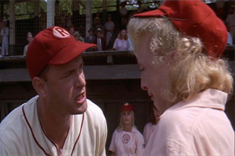
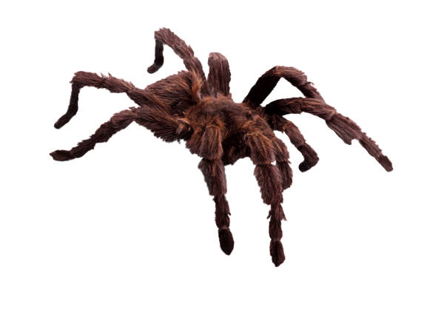
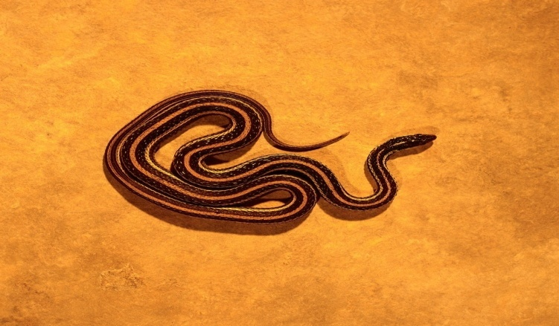
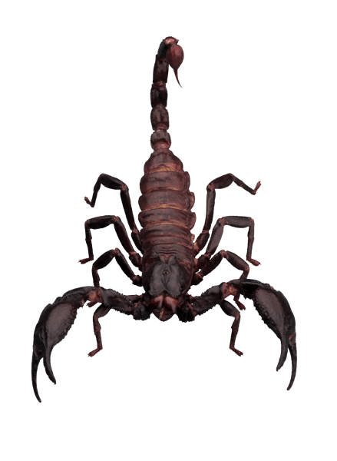
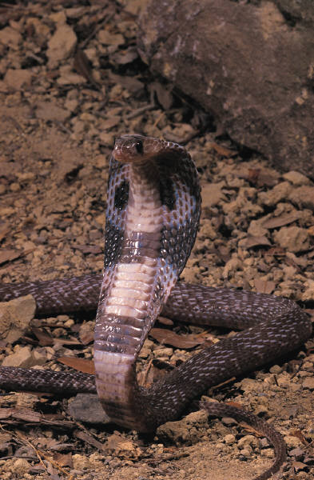
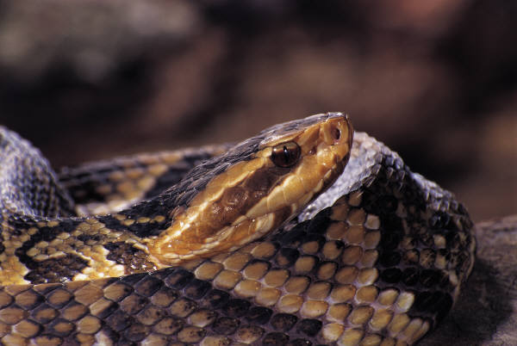
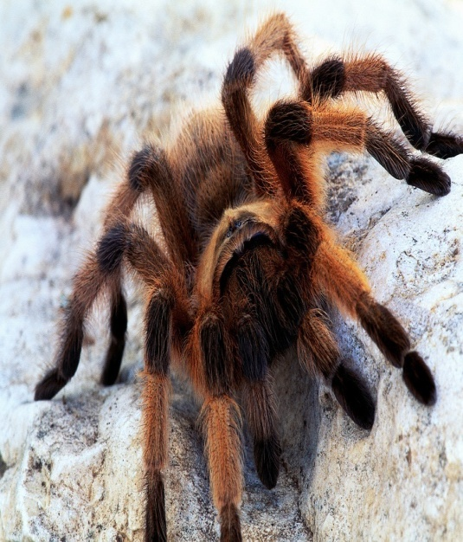
What are your topics?
Notes:
How do you decide what your topics are?
The answer is pretty easy.
All this takes is a
Brutally honest
Gut wrenching
And
Painful examination of your case.
Your Voir Dire topics are :
Those case facts that worry you and quite frankly scare you the most.
The worst facts
The most controversial issues
The circumstances or events that you fear will cause you to lose sleep.
Add to this list a short discussion on the burden of proof
and
if you have time and are skilled enough,
Planting a few seeds that can be developed into persuasive themes in opening and you have it made.
In the words of Tom Hanks, there’s no crying in baseball [CLICK UP TOM HANKS]
And in our shop, -- There’s no fear in voir dire.
There is no topic, not one out there, that we can’t find a way to discuss in a group.
That we can’t handle and that we can’t benefit from

Slide 7
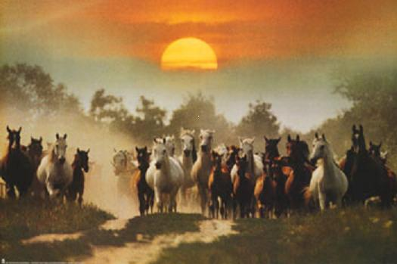
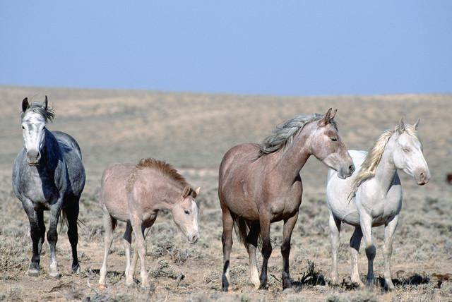
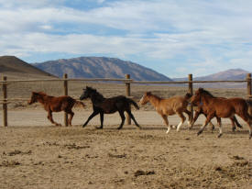
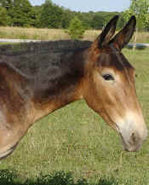
Sorting
Followers
The Panel
Power Brokers
Challenge for Cause or Strike
Notes:
Now, I said
Your goal is to identify bias – and to be clear, bias against you, not for you
In order to do this, you have to set the voir dire up for panel members to get culled and moved to another pen – preferably the challenge for cause pen , but if you can’t get them all the way down the chute, at least to the bench conference pen.
There’s no roping in voir dire. You don’t get to catch your choices and haul them into the box.
The box gets filled by whats left after the sorting.
Your goal is to methodically sort the culls out of the herd.
In training horses, we call it cause and allow.
Cause the thing you don’t want them to do to be hard
and
Make [allow] the thing you want them to do to be easy.

Slide 8
Identifying Bias:
Cause & Allow
Permission to Disagree
Invitation to Disagree
Praise for Disagreeing
Invitation for Others to Disagree
Resist Persuasive Argument
Allow Seeds of Persuasion
Allow Negative or Unsupported Juror Expectation
Notes:
Set up your voir dire discussions by giving the panel members
Permission to Disagree
Invitation to Disagree
Praise for Disagreeing
Invitation for Others to Disagree
And
Probably the most important and the most difficult for lawyers--Resist Persuasive Argument
IF you give all of this work into helping a person tell you that she cannot be fair, why then turn around shoot yourself in the foot by being persuasive. All you will do is run your challenge for cause back into the middle of the herd and make it even harder to cull .
Use an open ended, narrative style of topic discussion to cause people to tell us their biases.
Billy Ray Johnson Slide– Explain BRJ Case

Slide 9
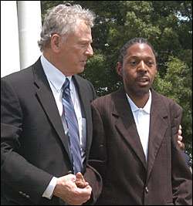
Center Wins Justice for Billy Ray Johnson
Texas couple plays key role in Johnson verdict
A civil jury in Linden, Texas, today awarded approximately $9 in damages to Billy Ray Johnson, a mentally disabled black man who was taunted, knocked unconscious and dumped along a desolate road by four white men in September 2003.
The Center brought suit on his behalf in 2005 after the men responsible for the crime received only light jail sentences — 30 days for three of them and 60 days for one.
"On behalf of Billy Ray Johnson, we thank the jury
— the conscience of Cass County — for returning a just and fair verdict," said Morris Dees, the Center's founder and chief trial attorney, in a statement to the media after the verdict. "The defendants in this case treated Billy Ray like trash.
Notes:
Texas couple plays key role in Johnson
Billy Ray Johnson, a mentally disabled black man who was taunted, knocked unconscious and dumped along a desolate road by four white men in September 2003.
4 white men took Billy Ray to a pasture party.
They taunted him
Called him names and then beat him unconscious. ….while several other adult men and women watched.
They then threw the body in a pickup truck, drove him to a garbage dump and left him on a cold night to die from exposure.
Billy Ray lived, but he was severely brain damaged.
The men responsible for the crime received only light jail sentences — 30 days for three of them and 60 days for one which were suspended.
After this outrage, the SPLC sued the men civilly in an attempt to reach a most just verdict.
We started out with 400 panelists
All filled out a juror questionnaire, which we designed.
This number then went to 114
Then to about 60.
After a four-day trial that began on April 17, the jury of 11 whites and one black deliberated less than four hours before returning a unanimous verdict finding the 4 responsible for Johnson's injuries A verdict of 9 million dollars.
In Billy Ray’s case, we made it easy, really easy, for people to criticize
Personal Injury Lawyers
To call them shady, greedy crooks
We found a way for racially biased people to tell us they didn’t want anything to do with a person they believed was playing the ”race card”
For money
We thanked them when some panelists called our lawyers publicity hounds
We said thanks when they told us we were in the case only for our 40%
And
One by one, with a smile on our faces and a kind word, we successfully challenged for cause until a panel of 400 went to a panel of 114 went to a panel of about 60
We allowed negative juror expectation – especially about fees. Any monies we secured for Billy Ray were going straight to him – Southern Poverty Law Center paid for everything --- but there was no reason we would want to emphasize that during voir dire,
By staying relatively silent on this issue, we were able to develop biases against personal injury trial lawyers to the point that we didn’t have to burn a strike on them

Slide 10
Prospective Jurors
This questionnaire obtains information from you regarding your qualifications to sit as a juror in this case.
You must answer every question as completely as possible.
This information will become part of the Court's permanent record, but it will not be given to anyone except the attorneys and judge in this case. Any answer or explanation that you want the attorneys to ask you about in private, please write the word 'PRIVATE' next to the question. Because this questionnaire is part of the jury selection process, the questions must be answered by you and you alone.
PLEASE REALIZE THERE ARE NO RIGHT OR WRONG ANSWERS.
CAUSE NO. 05-C-534
This is a civil case for money damages.
The plaintiff is Billy Ray Johnson, a mentally challenged Black man.
A lawsuit has been filed on behalf of Billy Ray Johnson by Next Friend, Lue Wilson .
The case involves allegations that Billy Ray Johnson was seriously injured by Corey Hicks [James Corey Hicks], Wes Owens[John Wesley Owens], Colt Amox [Christopher Colt Amox] and Dallas Stone [Dallas Chadwick Stone] in September 2003 here in Cass County.
The defendants in this case dispute these allegations.

Slide 11
Age:
Address: City: Zip:
Gender:
Your Race:
Current Marital Status:
□Never married □Married □Married but divorced, now single □Widow[er]
Describe your employment and your duties [if retired, list employment when working:
Have you ever been responsible for hiring or firing? □ Yes □ No, If “Yes” , please explain:
Have you ever responsible for supervising employees? □ Yes □ No, IF “Yes” please explain:
Describe your spouse’s employment and their duties [if retired, list employment when working]:
List your children’s age, gender, and employment or schools as applicable:
Where were you born? Where have you lived most of your life?
How long have you lived in Cass county?
Number of your years of education:
If graduated from college, what was your major and degree?
Number of your spouse’s years of education:
If graduated from college, what was the major and degree?
Have you served in the military? □ Yes □ No Years served:_____ Rank: ______

Slide 12
Some people believe there are too many personal injury lawsuits in Texas and their feelings are so strong that they have a prejudgment about this topic. Do you generally hold a negative opinion about personal injury lawsuits?
□ Yes □ No, If “Yes”, please explain:
In a civil case, the only kind of damages a person filing a lawsuit (the plaintiff) can receive is a monetary award. Some people believe that there should be a cap on the amount of money they would award regardless of the evidence or the type of case. Do you have a dollar amount in your mind above which you would not award money regardless of the evidence in the case? □ Yes □ No If “Yes”, please explain:
Are you generally opposed to awarding money for mental anguish? □ Yes □ No If “Yes”, please explain:
Some people believe it is wrong to give a high verdict because of the effect it could have on the defendant. If the evidence supported a high verdict, would you be unwilling to give such a verdict because of concerns about the financial effect on the defendant? □ Yes □ No If “Yes”, please explain:

Slide 13
Please check the statement that most closely reflects you opinion:
√ □ There are no racial prejudice problems in Cass County.
√ □ There are only a few racial prejudice problems in Cass County
□ There are a lot of racial prejudice problems in Cass County.
□ There is a huge amount of racial prejudice problems in Cass County.
Please explain your answer:
This is a civil case for money damages. The plaintiff is Billy Ray Johnson, a mentally challenged
Black man. A lawsuit has been filed on behalf of Billy Ray Johnson by his cousin, Lue Wilson.
The case involves allegations that Billy Ray Johnson was seriously injured by Cory Hicks,
Wes Owens, Colt Amox and Dallas Stone in September 2003 here in Cass County.
The defendants in this case dispute these allegations.
√ Do you personally know any of these people or personally know any of their
family members or someone they are close to? □ Yes □ No If “Yes”, Please tell us who
and how you know them:
√ After September 2003, have you seen or had any contact with an
any of the above named people? □ Yes □ No If “Yes”, please tell us who and how you know them:
√ Have you read or heard anything about this case before today? □ Yes □ No
If “Yes”, Please tell us what you know:
√ Are you in any way bothered by the media attention to this case? ? □ Yes □ No If “Yes”,
Please explain:
Is there any reason why you could not serve as a fair and impartial juror in this case?
□ Yes □ No
√ If “Yes”, Please explain – or if you prefer mark “private” and we will discuss your reason privately.
□ I prefer to discuss my reason privately
Explanation:

Slide 14
Challenge for Cause
Leaning toward one side or the other is not enough to show bias.
Focus on deliberation.
Focus where they will end – their verdict.
Notes:
Case law varies, of course, from state to state.
These are some differences in Challenge for cause from court to court.
But permit me to give you some pointers in Texas…….

Slide 15
Striking the list
1 | 2 | 3 | 4 | 5 | 6
7 | 8 | 9 | 10 | 11 | 12
13 | 14 | 15 | 16 | 17 | 18
19 | 20 | 21 | 22 | 23 | 24
25 | 26 | 27 | 28 | 29 | 30
X
X
HARD
SHIP
CC
X
CC
CC
X
X
X
CC
HARD
SHIP
HARD
SHIP
Notes:
Hardship
Challenge for Cause
Strikes
The resulting jury

