Slide 1
Family Law Jury Trial
Mike McCurley
Janet McCullar
John Eck
Kay Radburn
Hon. Mary Ellen Hicks
Moderator: Jan Marie DeLipsey, Ph.D.

Slide 2
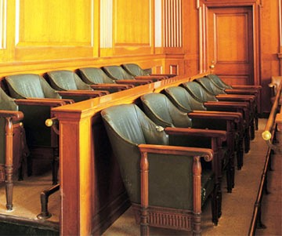
Jury Selection
Jury De Selection
INSERT PHOTO OF JURY HERE

Slide 3
Goal?
Seat a jury which will be open to
Your Argument.

Slide 4
Challenge- Strike Model ©

Slide 5
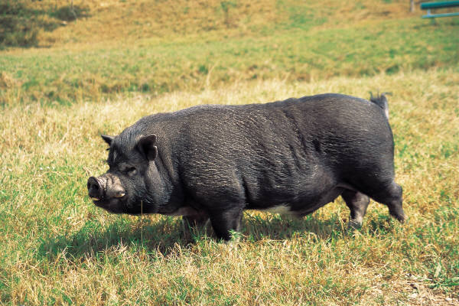
Panelists are not blank slates
Strong moral convictions will not be abandoned
Monique

Slide 6
How?
Construct a Voir Dire that will
yield enough information to:
Identify Biases
Successfully Challenge for Cause
Effectively Use Pre-emptive Strikes

Slide 7
What are your topics?
Any area of Bias

Slide 8
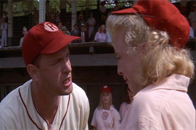

Slide 9
Poison?
Opportunity

Slide 10
CHALLENGE/STRIKE CHECKLIST©
ISSUE | DATA SOURCE
 | Voir Dire | Juror Questionnaire | Other
People who believe mothers are better parents than fathers | X
People who believe that mothers are better parents for girls than fathers | x | X
People who believe that mothers are better parents for pre school children than fathers. | x | X
Stay home mothers of pre-school children |  | X
 |  | X

Slide 11
Please mark all that would apply in terms of what you believe about the following statement:
“Girls should be raised by their mother.”
❒Strongly Agree
❒Agree
❒Depends on their ages
❒Depends on their preferences
❒Depends on : ____________________________
❒No beliefs about it one way or the other
❒Disagree
❒Strongly Disagree
Comments:

Slide 12
Putting Advocacy Aside
Permission to Disagree
Invitation to Disagree
Praise for Disagreeing
Invitation for Others to Disagree
Allow Negative Juror Expectations

Slide 13
Practice Tips:
Challenge for Cause
Starting out leaning toward one side or the other is not enough to show bias. (usually)
Focus on how attitude will impact deliberation.
Focus on how attitude will impact the - their verdict.

Slide 14
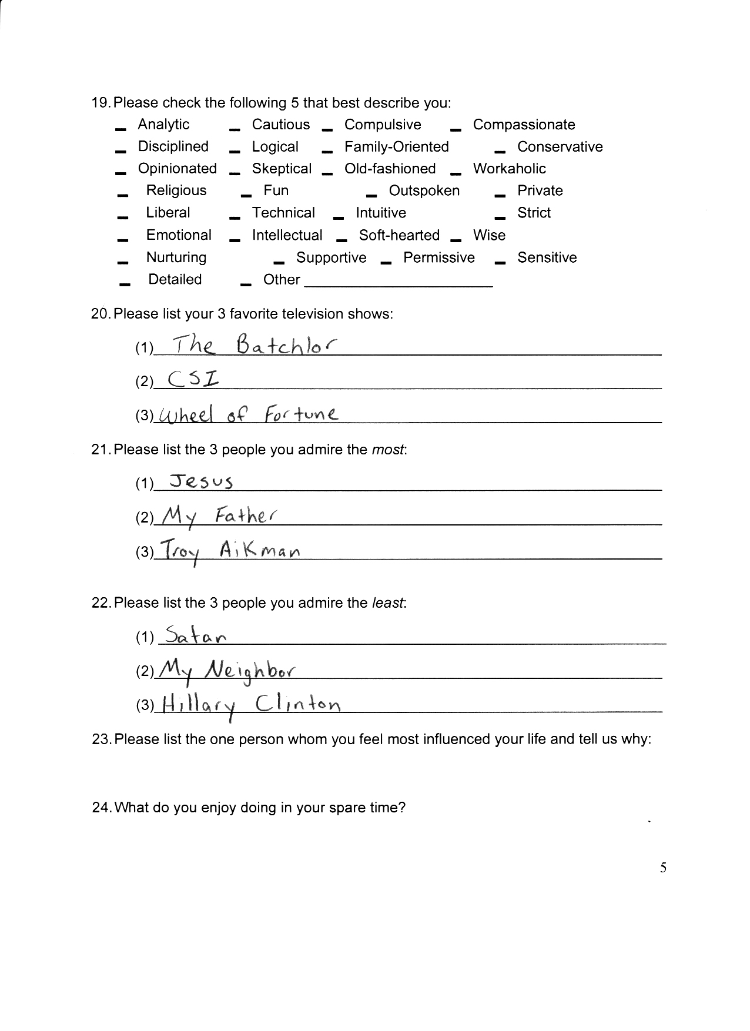

Slide 15

www.litigationedge.net

